Slide 1
BIOL 792 (1028)
Data Science for Biology I
Online
Tuesday and Thursday 6:00 – 7:15
Dr. Thomas Parchman

Slide 2
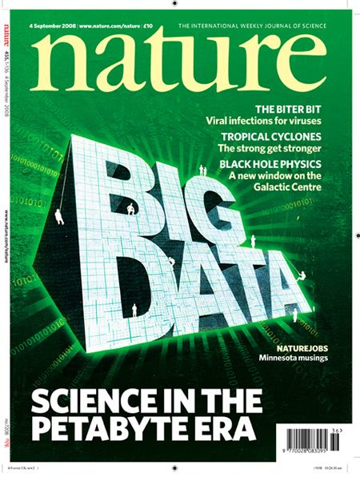
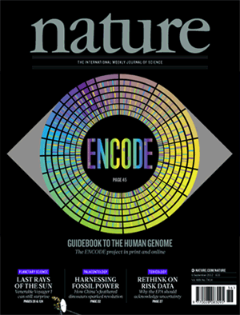
Notes:
Data is getting big. Accumulation of data is outpacing the ability of biologists to handle it.
This is most apparent for genomics, but is occurring in all areas of biology. For example, climate science. In many areas of biology, the growth of data is outpacing the ability of biologists to handle it.
The reason the growth of this data is outpacing the ability of biologists to handle this is that biologists have not been traditionally trained to learn basic programming skills.
The purpose of this class is rather practical. It is to equip you with tools you need to start feeling enabled towards working with bigger data.
Excel and Statistics GUI packages are useless. By learning some basic computational tools you can not only enable yourself to handle this type of data, but you can free yourself from the constraints of prewritten programs.
It takes time, a lot of time to pick up some of these skills. Nonetheless, with some basic understanding of unix, and simple programming languages such as perl or python, a lot of basic important things can be learned and used fairly quickly.
The point of this course is to give you a basic introduction to the tools you need to get started.

Slide 3
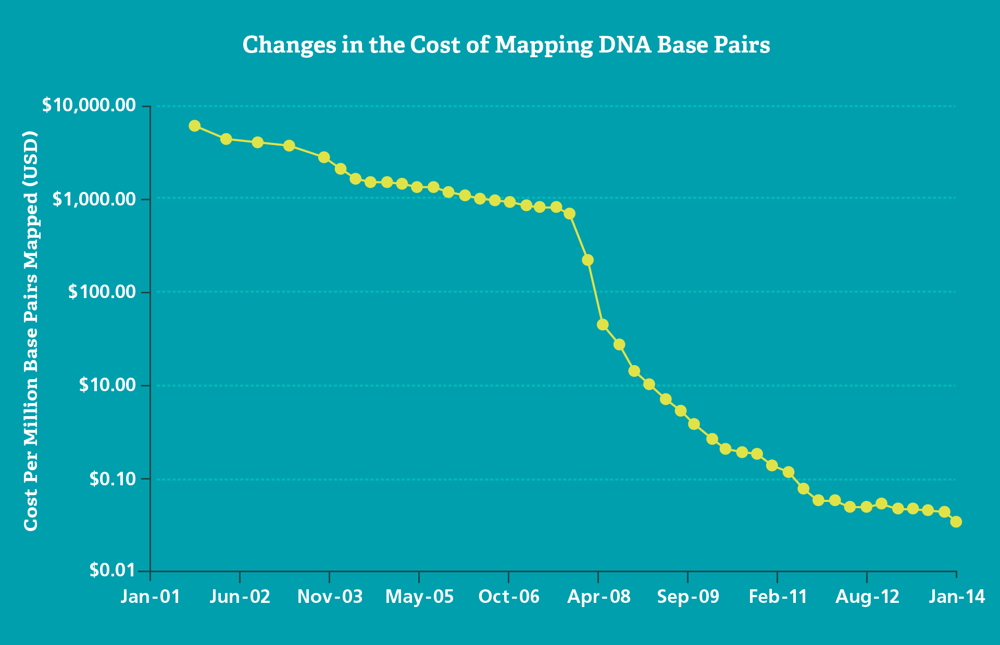
Big Data Science: Genomics
Next generation
sequencers
Cost of DNA sequencing is now 1,000,000 times cheaper and about 100,000 times faster than 10 years ago
Notes:
The growth of big data is perhaps most evident for any field of biology that deals with DNA or RNA sequence data.
Up until 2007 or 2008 empirical genetic studies were typically based on single locus DNA sequences, small sets of molecular markers, or collections of ESTs for more intensively studied organisms.
With the advent of next generation DNA sequencers, the cost of sequencing plummeted. Its even cheaper today, so its almost a million times cheaper than it was just 8 years ago. Perhaps more importantly than that, Lab work takes almost no time at all.
We can routinely generate massive data sets after a few days of lab work and for very small amounts of money.

Slide 4
Human Genome Project (1990- 2003)
First draft human genome released in 2003.
- 3,000,000,000 dollars, 13 years, 100s of people
De novo whole genome sequencing today
- About $25,000 for a genome of a non-model organism
- Nature 2020: One paper with 350 bird genomes

Slide 5
Example of change for population genetics
Then (10 years ago)
Now
400 individuals, 15 microsatellite loci
6000 PCR reactions after troubleshooting, and before reruns
PCR products run separately for each individual and each locus
- 6-12 months of lab work
- 15 loci, $16,000.00
400 individuals, pooled Illumina sequencing
- 400 PCR reactions
- 3 days of lab work
- 900,000,000 DNA sequences, maybe 80,000 SNPs, $6,000.00

Slide 6
Next Generation DNA sequencing in Evolution and Ecology
Whole Genome Sequencing
Population genomics
Phylogenomics
Gene expression (RNAseq)
Metagenomics
Transcriptomics

Slide 7
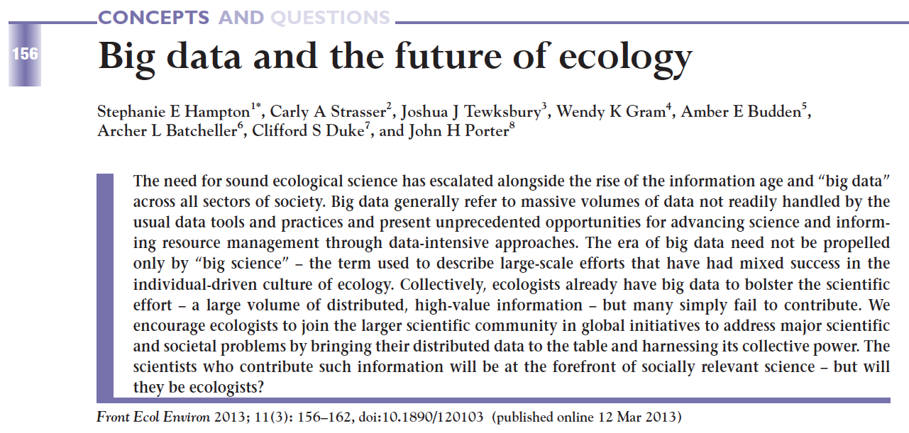
Big data is relevant for all of biology
Notes:
Big data is not unique to genomics. It is also increasingly characterizing other areas of science such as Ecology, epidemiology, medicine, physics, and even animal behavior.

Slide 8
Why learn to use Unix?
Accessing, manipulating, and moving large data sets around (around your
computer, or among computers).
Connecting to remote computers and high performance computing clusters.
>250,000 built in tools and commands
System navigation: Everything you do with your mouse, you can do much much faster and efficiently from the terminal
First step at becoming enabled for data science

Slide 9
Why learn Python (or Perl)?
- Among the most common languages used in biology and other fields of science. Thus, you will be able to find a lot of documentation, guidance, examples, and opinion on the web.
- It has excellent capabilities for manipulating text, suiting it well to bioinformatics and data science.
- It uses consistent syntax, which makes learning specific code relatively easy.
- It has many built in libraries to facilitate common tasks.
- If you learn this as your first language, it will make learning others much easier.

Slide 10
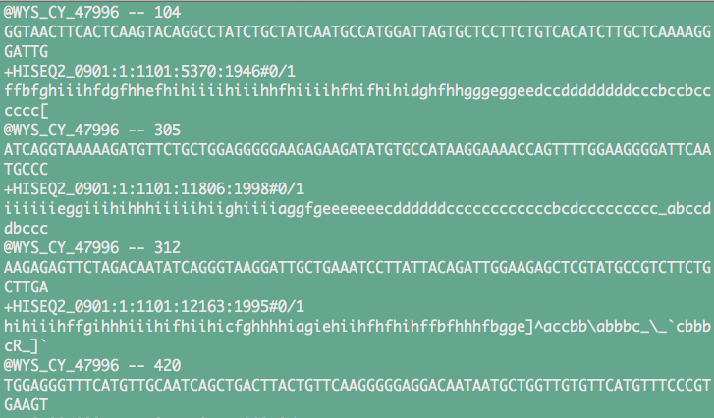
Information from the first four DNA sequences from a data file that has 800,000,000 DNA sequences generated with an Illumina HiSeq instrument

Slide 11
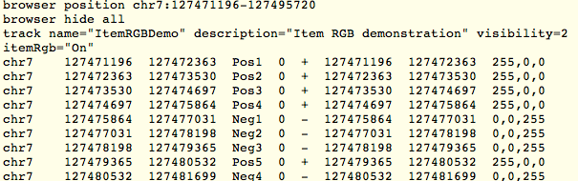
GFF File (Genome alignment information)
15,000,000 lines with alignment information

Slide 12


Slide 13
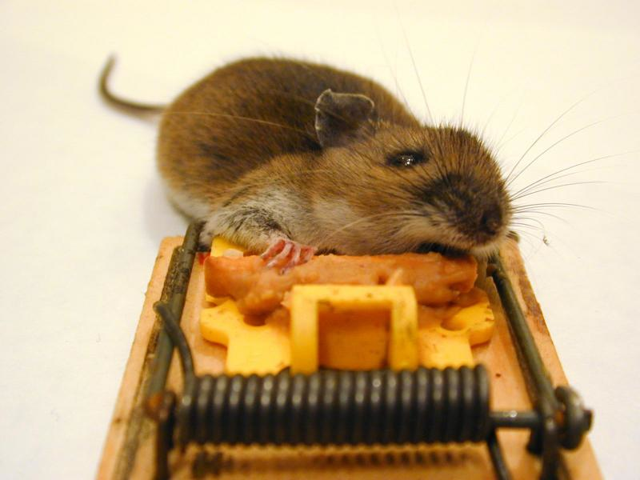
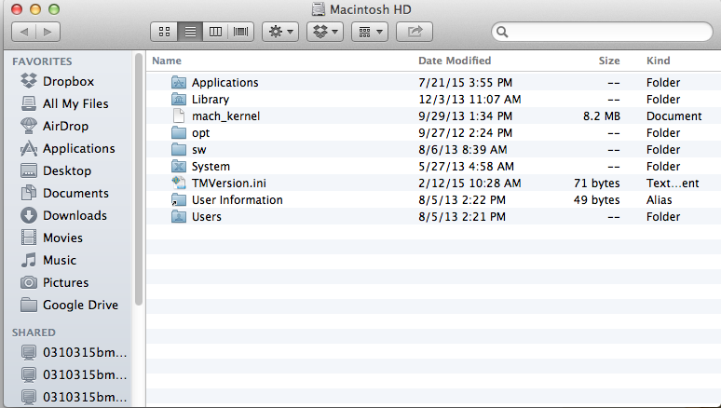

Navigating Directories

Slide 14
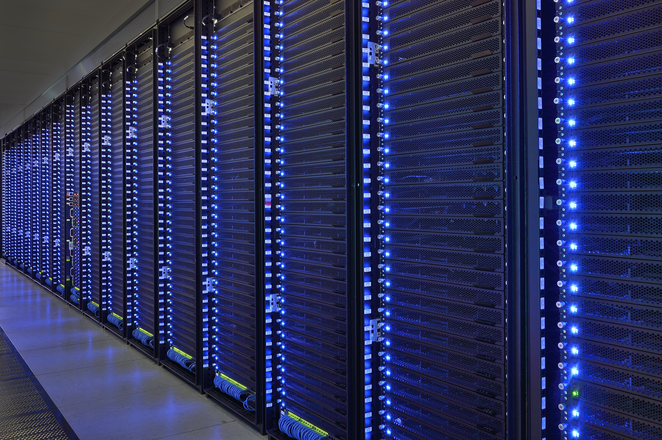
High performance computing clusters are accessed and run with Unix (or Linux)
Unix tools: ssh, sftp, wget, ftp, job schedulers (torque, sungrid engine)

Slide 15
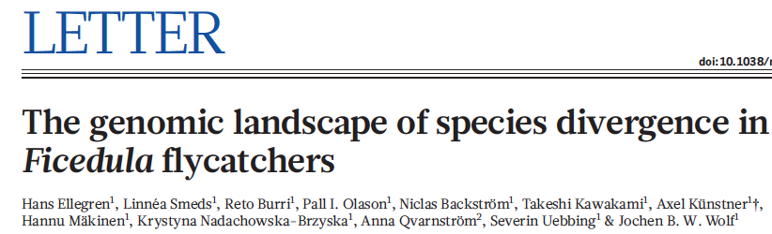
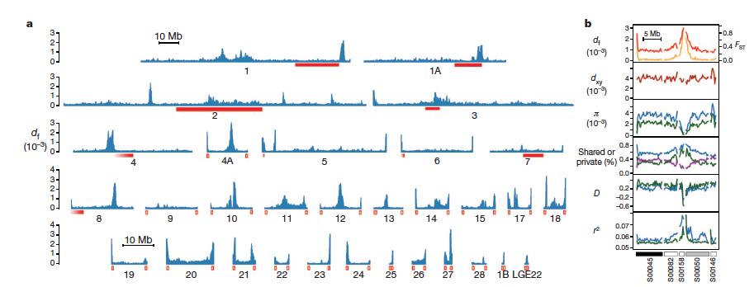
Example genomics paper
Virtually all programs written to analyze genomic data (and other big data) are meant to run from the terminal and many rely on Perl or Python scripting

Slide 16
At the end of this course, you should:
Be comfortable with using Unix for basic and slightly more advanced needs
Be able to write basic programs in Python (and feel encouraged to learn more on your own).
Be able to use Unix, Python, and shell scripting to manipulate, organize, and analyze large data sets.
Feel enabled and equipped to work with big data, and motivated and capable of learning more on your own.
Be prepared for Julie Allen’s Data Science for Biology II, spring semester.

Slide 17
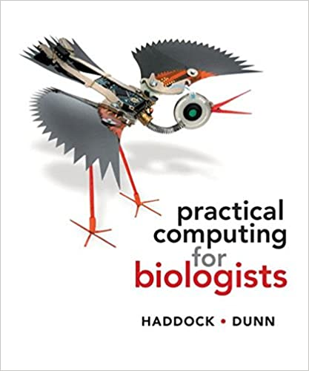
Course Resources
Computer with Unix and Python installed, preferably mac or machine running linux.
Supplementary data and problem sets for projects will be provided throughout the semester on the course github page.
Text book (to left), and supplemental unix material from ”Unix and Perl to the Rescue”, Bradnam and Korf.

Slide 18
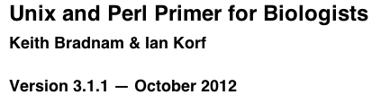
Other suggested resources:
Primer for a supplemental book that is very useful for Unix (and learning Perl if you so desire)
http://korflab.ucdavis.edu/Unix_and_Perl/current.html

Slide 19
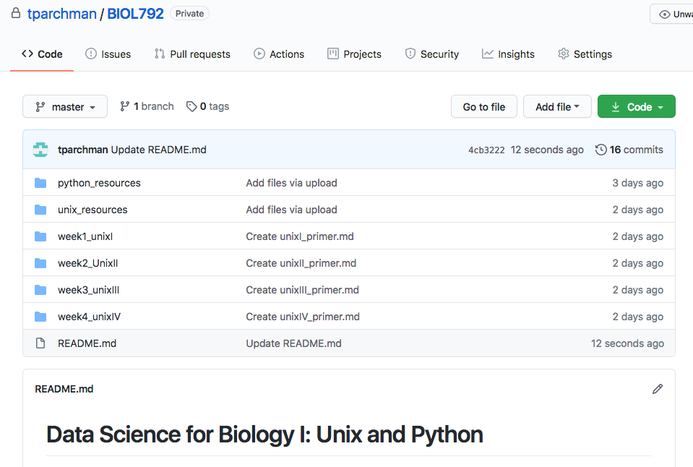
Course site: https://github.com/tparchman/BIOL792_course_site
Weekly primers and task/problem assignments
Supplemental material for learning Unix and Python
Repositories for sharing code with each other

Slide 20
Course Outline
Weeks 1 through 3/4: Learning how to live in the Unix environment
-directory navigation, moving, copying, syncing
-basic Unix tools for efficient data handling
Weeks 3/4 through 10/11: Basic programming in Python
-input/output, basic syntax, debugging
-data structures (scalars, arrays, hashes)
-regular expressions, mathematical operation, indexing, data wrangling
Weeks 11 through 15: Incorporating what you have learned in Unix and Python to manipulate and analyze some big data sets
- Some of these problems may involve data from my lab, some may involve data and problems supplied by your classmates, and some will be for your independent projects.

Slide 21
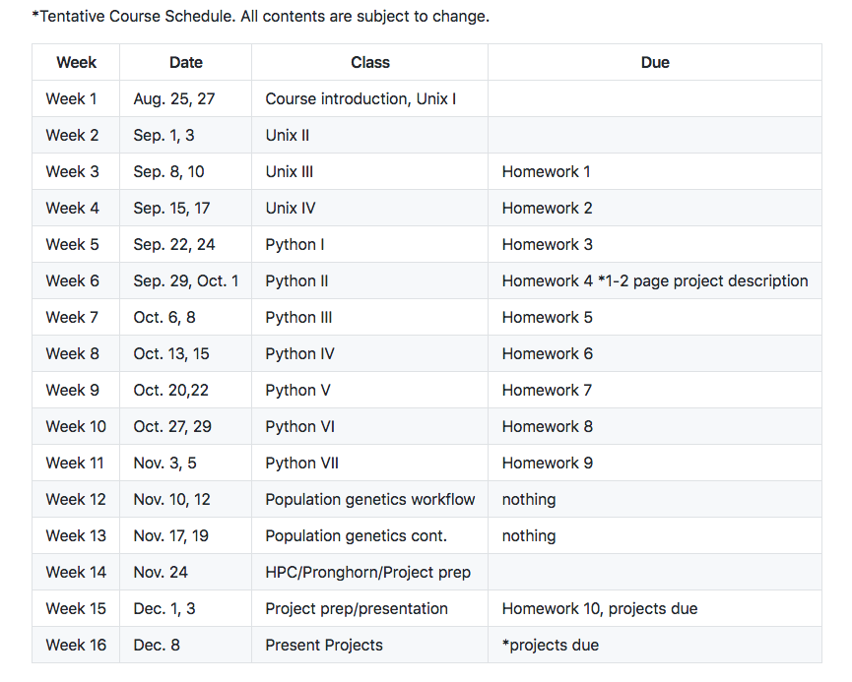
Note: Timeline in the syllabus will shift depending on the pace of the class

Slide 22
Grading for the course:
Participation (30%)
Weekly Assignments (50%)
For weekly assignments, you can (and I highly recommend) work in teams of up to THREE. Starting materials for projects will be supplied in directories that contain a type of data file, an explanation of the problem, and advice on how to use Unix, Python, or R to parse data, conduct some analyses, or just do some stuff.
For these projects, and especially for real world computational projects, keeping track of EVERYTHING you do will be essential.
For Unix projects, you will turn in annotated notes of the commands you executed and what they accomplished.
For Python projects, you will turn in your scripts, with comment lines used to explain your rationale.

Slide 23
Grading for the course (continued):
3. Independent (or group) project (20%)
You may work independently, or in a group of up to THREE.
Identify a task or problem in your research (or the research of the group you work within) that either requires, or can be made much more efficient, using Perl or Unix scripting. The idea here is to force you to identify a real problem, and to build something useful to solve it.
Deliverables:
Before week 5: Turn in a 1-2 page description of the problem, the data, and how you plan to implement something in Unix, Python, or both, to get something done.
By week 14: Turn in your Unix and/or Python code and a 1-3 page description of how your creation works
Weeks 14/5. 10-15 minute presentation to the class on your problem and how you solved it.

Slide 24
Before Thursday:
Read Haddock and Dunn (pgs 1-15 only), first half of Chapter 4.
Make sure you have access to a computer with Unix/Linux
If you have a mac, you are set
If you can run linux (ubuntu for example) on your computer, you are set.
If you have a PC, read up on options in week1 primer
3. Pick and install a text editor. (You will not want to use notepad or a word processing software). I strongly suggest TextWrangler, as does the Haddock and Dunn book. Get yourself acquainted with the program. If you have experience working with other syntax recognizing text editors, feel free to use your favorite flavor (I prefer emacs).

Slide 25
Why use more advanced text editors?
- Programs are typically just text files; they contain text written commands for operations, functions, input/output, etc.
Microsoft Office Documents and Excel documents are NOT text files; We will NOT be using either in the class.
Syntax recognition is built into editors used for programming (VIM, Emacs, TextWrangler)
**This will help with understanding the code you are writing, and more importantly in debugging.

Slide 26
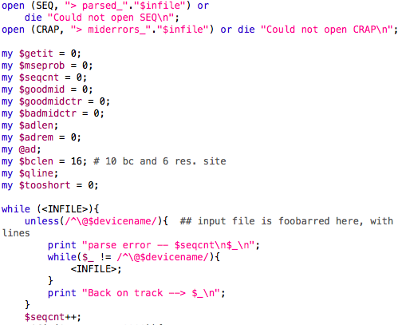
TextWrangler – Recommended for this class
Perl
script

Slide 27
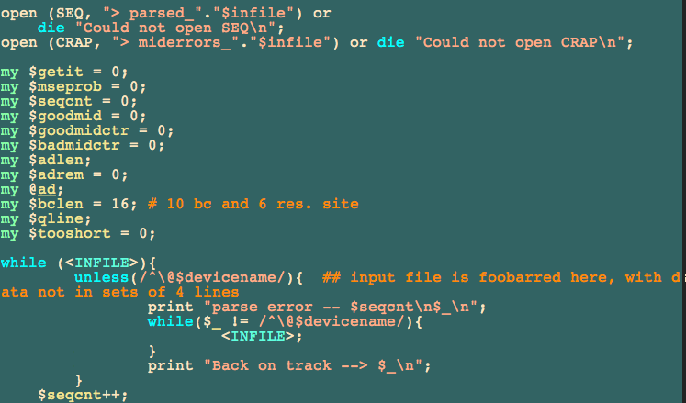
Emacs – Much more enabled and advanced
Same Perl script

Slide 28
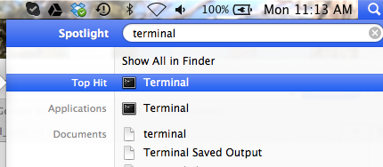
Introduction to the terminal
Put a link somewhere to make opening this quick, as you will use it for everything in this course (add it to your dock on a mac)

Slide 29
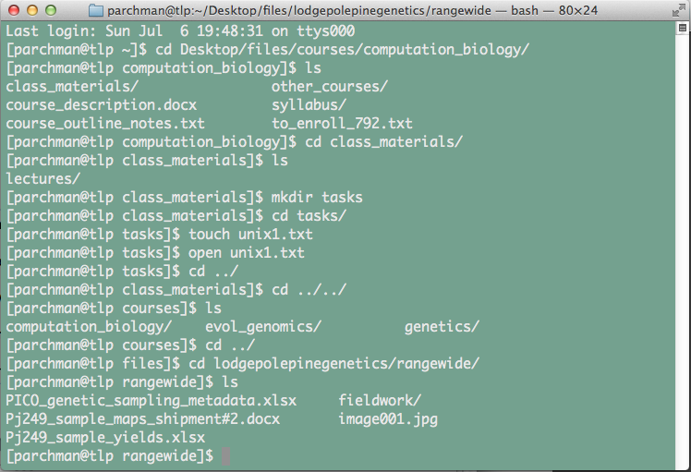
- make the text larger/smaller (hold down ‘command’ and either ‘+’ or ‘–’)
- resize the window (this will often be necessary)
- have multiple terminal windows on screen (see the ‘Shell’ menu)
- have multiple tabs open within each window (again see the ‘Shell’ menu)
Command ‘N’ to open additional windows

Slide 30
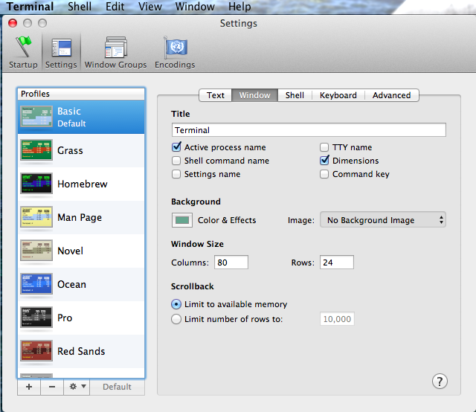
Customize Terminal
Background color,
text size,
font, color, etc.

